Slide 1
Introduction to Deep Learning
Traffic Sign Detection using CNN
Presented by: Group #09
Yash Deshpande
Sudip Bala
Pranshu Shrivastava
Abhishek Ayachit

Slide 2
Problem Statement
To develop models based on Convolutional Neural Networks (CNN) architecture to identify and classify Traffic Signs with minimum misclassification error on the German Traffic Sign Dataset.
To explore different CNN Architectures such as:
RESNET
Our Proposed Model
To compare the performance of different architectures

Slide 3
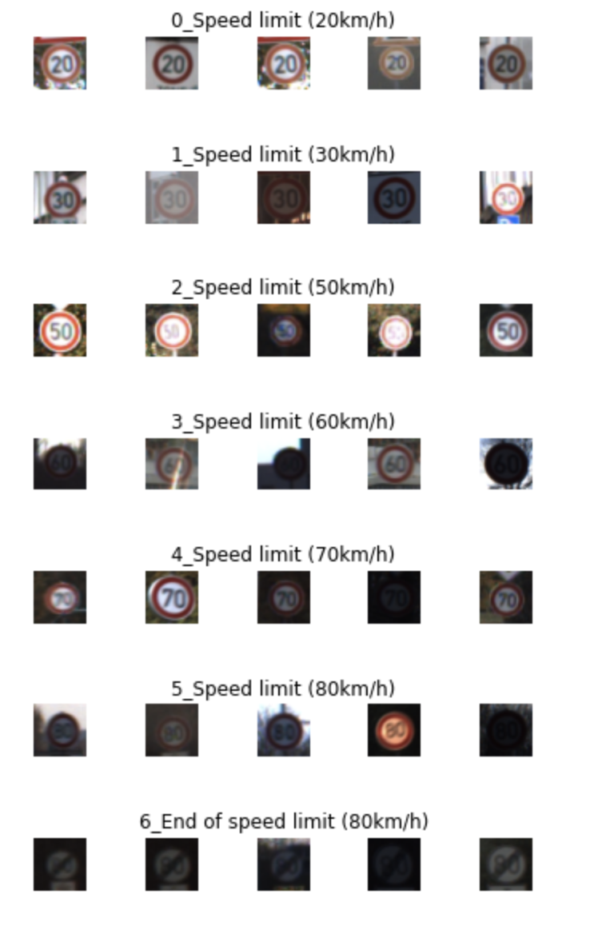
Dataset
Dataset contains more than 50000 images with more than 40 classes.
Image Attributes:
Width
Height
upper left and lower right x-y coordinates
ClassId
Path of the image

Slide 4
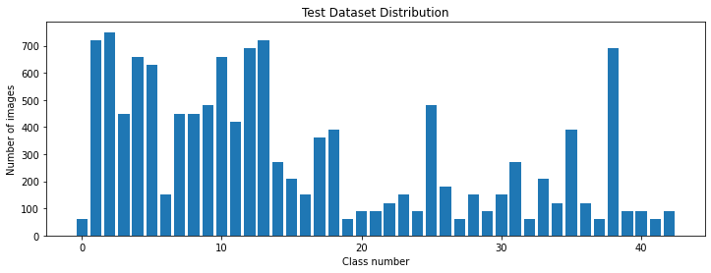
Dataset: Distribution of Training Data

Slide 5
Preprocessing
Initialization
HE-Normalization: the weights are initialized keeping in mind the size of the previous layer which helps in attaining a global minimum of the cost function faster and more efficiently.
Also suitable for ReLu Activation
Normalization
Why normalization?
One Hot Encoding:
Converted Numerical data into binary.

Slide 6
CNN Architecture
The neurons within a CNN are split into a three-dimensional structure, with each set of neurons analyzing a small region or feature of the image. In other words, each group of neurons specializes in identifying one part of the image.
CNNs use the predictions from the layers to produce a final output that presents a vector of probability scores to represent the likelihood that a specific feature belongs to a certain class.

Slide 7
CNN Architecture : Layers
Convolution Layer: Creates a feature map to predict the class probabilities for each feature by applying a filter that scans the whole image, few pixels at a time.
Pooling Layer(downsampling): Scales down the amount of information the convolutional layer generated for each feature and maintains the most essential information.
Fully connected Layer—applies weights over the input generated by the feature analysis to predict an accurate label.

Slide 8
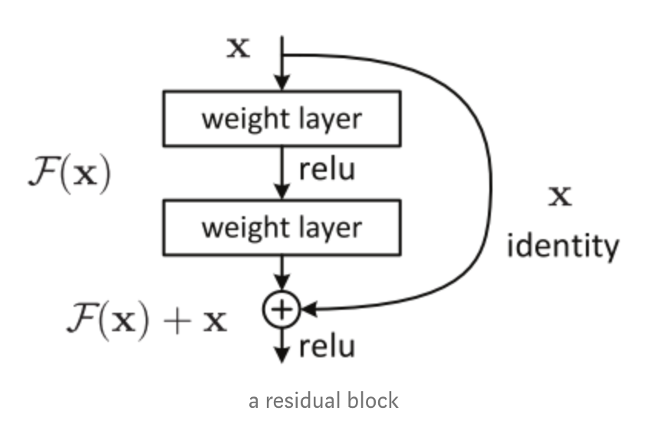
RESNET
Large neural networks tend to overfit given the large number of connections
Residual neural networks overcome this by utilizing skip connections, or shortcuts to jump over some layers. Typical ResNet models are implemented with double or triple-layer skips that contain nonlinearities (ReLU) and batch normalization in between.

Slide 9
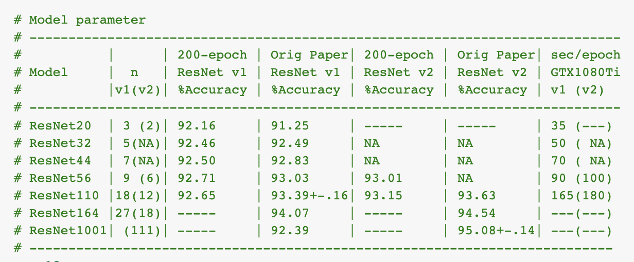
RESNET : Versions
Resnet implementation on CIFAR-10 dataset
Data Distribution

Slide 10
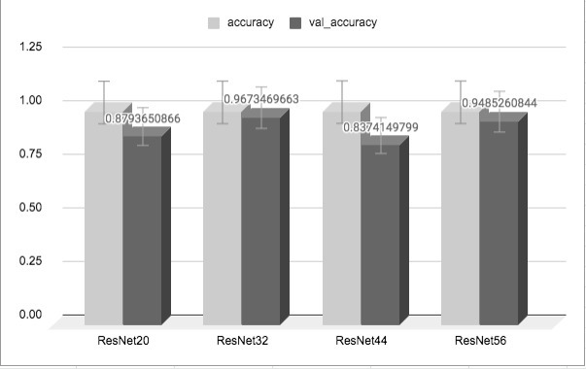
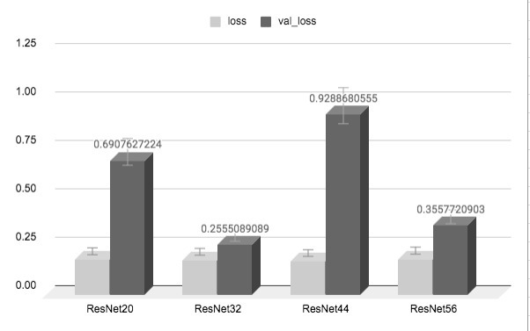
RESNET : W/O Augmentation

Slide 11
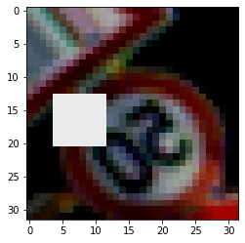
Data Augmentation
Standard Augmentation
Shifting, Flipping, Rotation, Brightness, Zooming
Cutout Augmentation
Dropping out contiguous sections of inputs

Slide 12
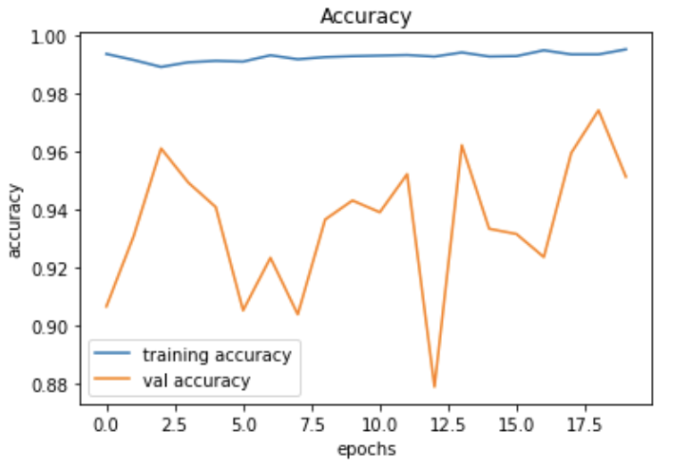
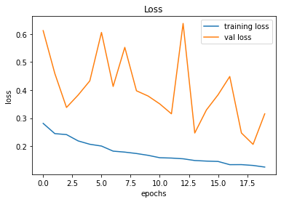
RESNET (With Augmentation)

Slide 13
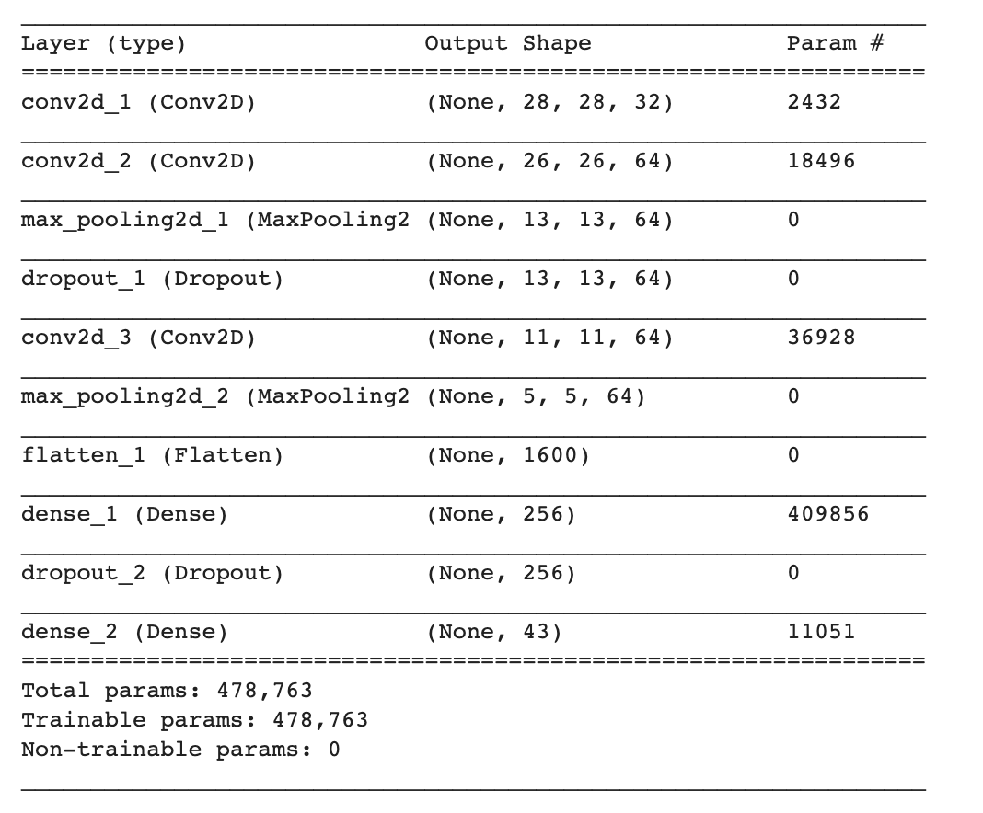
Proposed CNN Model

Slide 14
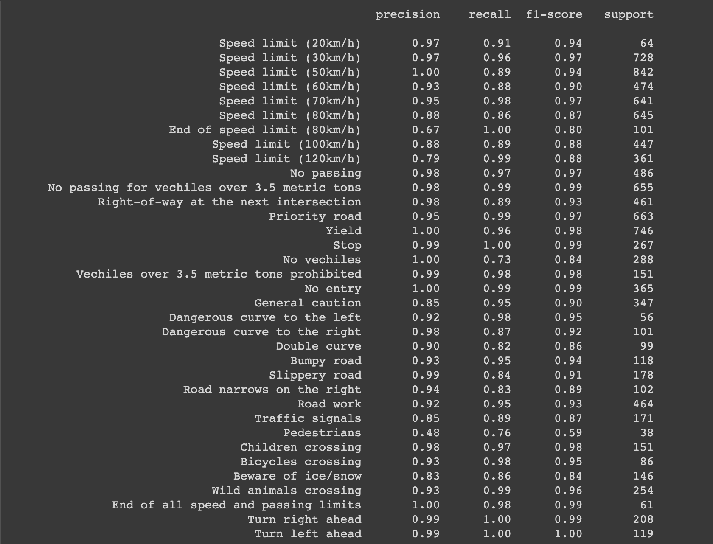
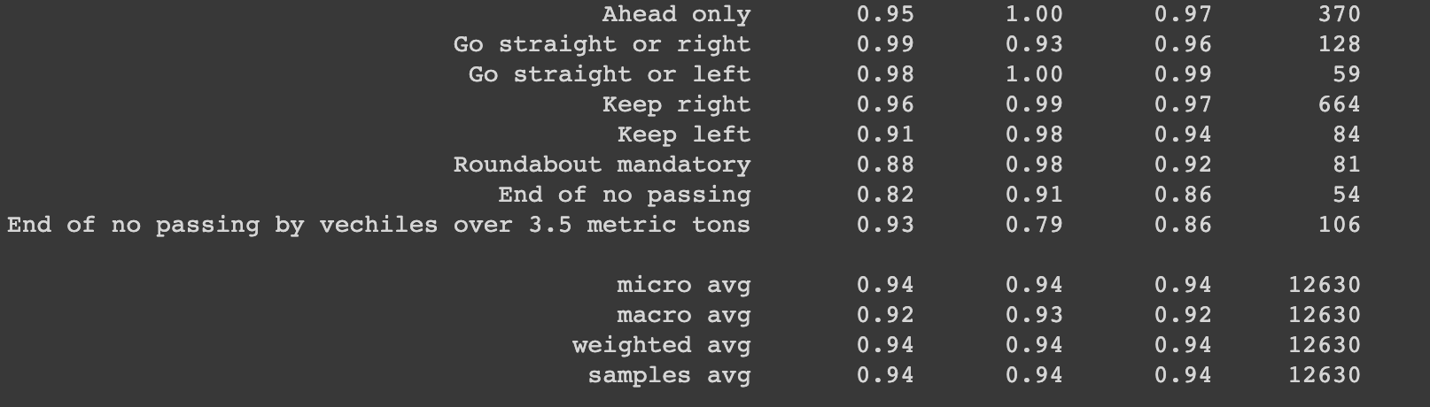
Results:

Slide 15
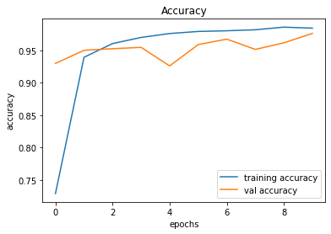
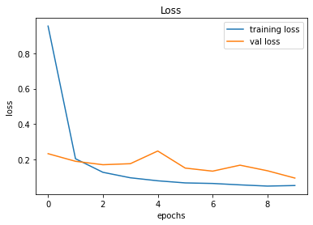
Results:

Slide 16
Remaining Work
Removing training bias
Add ‘Undecided’ class and check effects on our model
Implementation of Evaluation Metrics

Slide 17
Thank You

